Slide 1


New Product Introduction: EmaxPROgress

Slide 2
Before introducing EmaxPROgress,
let's look back at the evolution of Nakanishi's grinders.

Slide 3
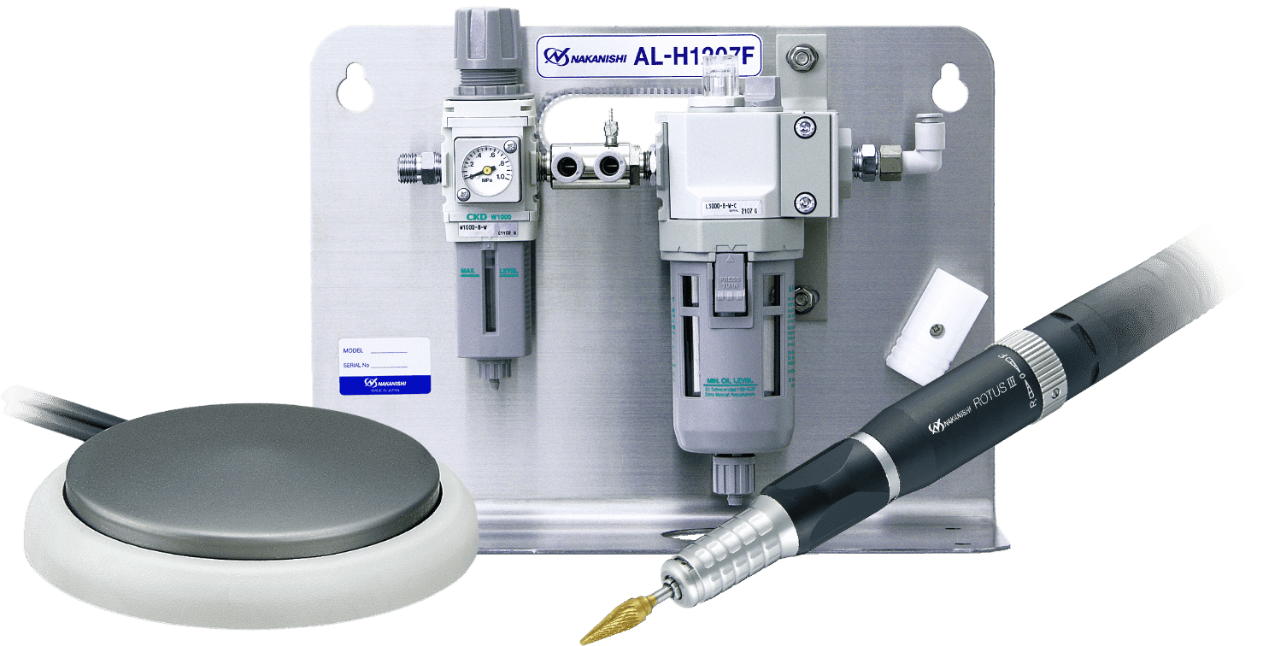
The Evolution of Micro Grinders
In 1982, we entered the industrial market with the ROTUS air grinder.
A high-performance air motor delivering high torque.
A wide range of interchangeable attachments.
Stable rotation speed without heat generation even during long use.
 | Brushed | Brushless
Air motor
3,000–30,000 min⁻¹
46 W

Slide 4

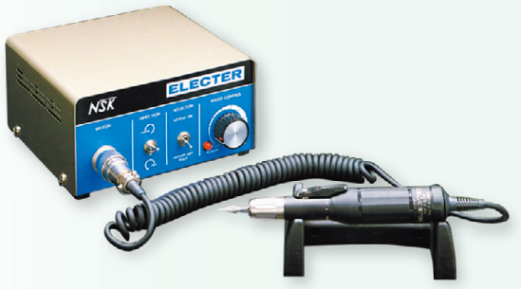
The Evolution of Micro Grinders
In 1984, the Electer made its debut.
The industry's first adoption of coreless motors.
Motor start/stop times were significantly shorter than those of other products available at the time.
It became the standard tool for jewelry engraving and deburring.
 | Brushed | Brushless
1984
Electer
Brushed coreless motor
1,000–35,000 min⁻¹
75 W

Slide 5

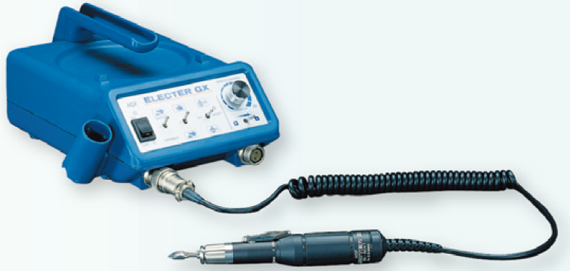
The Evolution of Micro Grinders
In 1990, the Electer GX made its debut.
A sleek control unit with a built-in handle.
Capable of connecting two motors, which made it a bestseller.
Succeeded in bringing coreless motor production in-house.
 | Brushed | Brushless
1984
1990
Electer
Electer
GX
Brushed coreless motor
1,000–35,000 min⁻¹
75 W

Slide 6


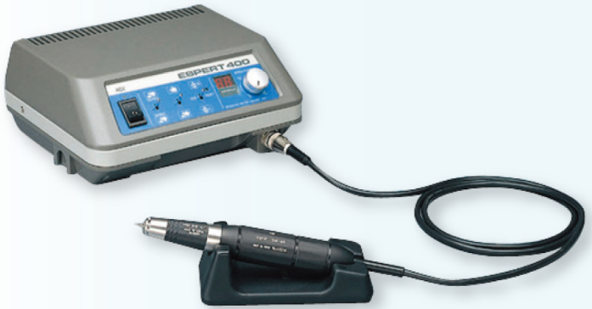
The Evolution of Micro Grinders
In 1992, the Espert made its debut.
Nakanishi's first in-house brushless motor.
High torque and outstanding smoothness.
Although it was a high-end model, it was widely adopted in Europe for its power.
 | Brushed | Brushless
1984
1990
1992
Electer
Electer
GX
Espert
Brushless motor
1,000–40,000 min⁻¹
130 W

Slide 7
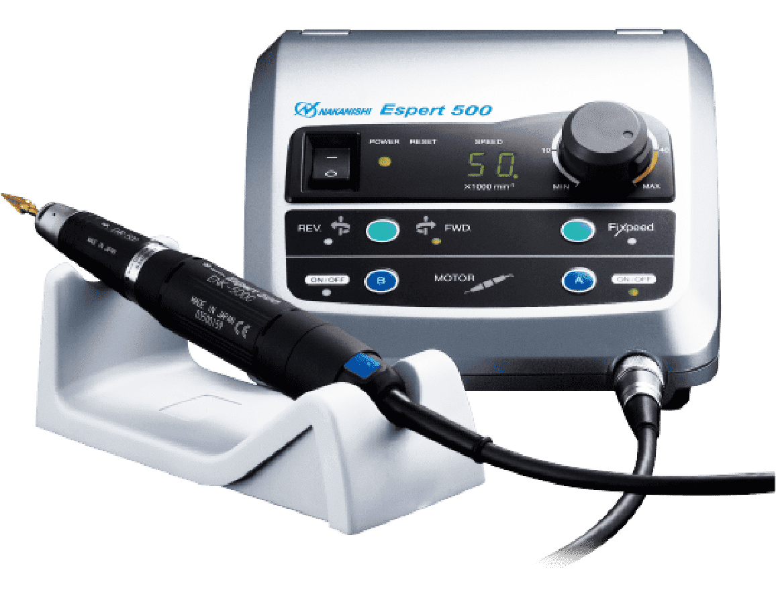
The Evolution of Micro Grinders
In 2000, the Espert 500 made its debut.
For the second generation, a smaller motor was developed, and the circuit technology was updated. Achieved a 20% cost reduction.
With a maximum rotation speed of 50,000 min⁻¹, it is widely adopted in the mold industry.
 | Brushed | Brushless
1984
1990
1992
2000
Electer
Electer
GX
Espert
Brushless motor
1,000–50,000 min⁻¹
200 W
Espert
500

Slide 8
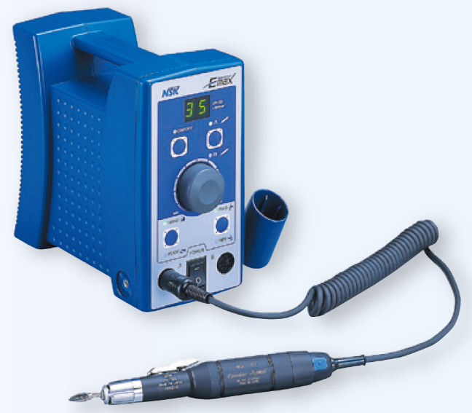


The Evolution of Micro Grinders
In 2001, the Electer E-Max made its debut.
A vertical unit designed for easy portability and installation.
A rotation speed display.
A built-in handpiece switch.
 | Brushed | Brushless
1984
1990
1992
2000
2001
Electer
Electer
GX
Espert
Brushed coreless motor
1,000–35,000 min⁻¹
75 W
Espert
500
Electer
E-Max

Slide 9
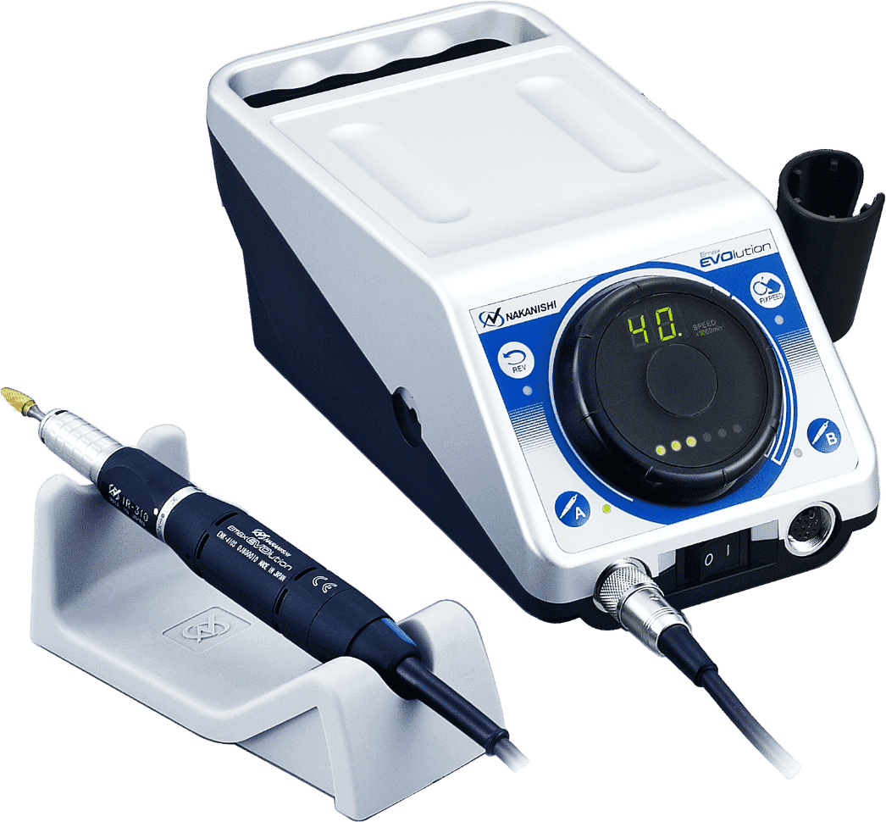
The Evolution of Micro Grinders
In 2008, the Emax EVOlution made its debut.
A large dial and load meter improve usability.
It uses a brushless motor that is the same size as the previous motor.
Its stable torque and ease of use have made it a long-running bestseller.
 | Brushed | Brushless
1984
1990
1992
2000
2001
2008
Electer
Electer
GX
Espert
Brushless motor
1,000–40,000 min⁻¹
80 W
Espert
500
Electer
E-Max
Emax
EVO

Slide 10
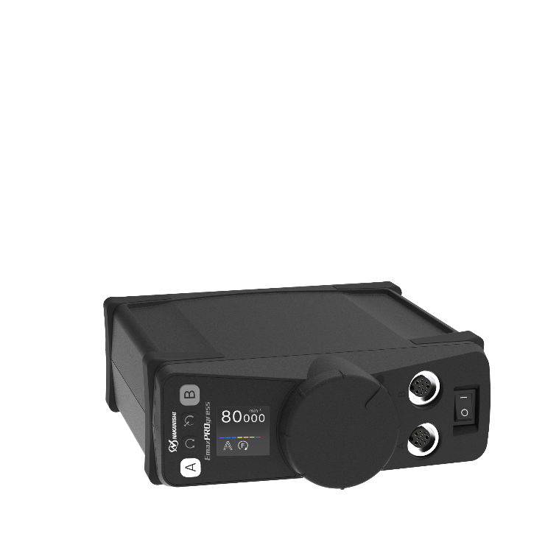
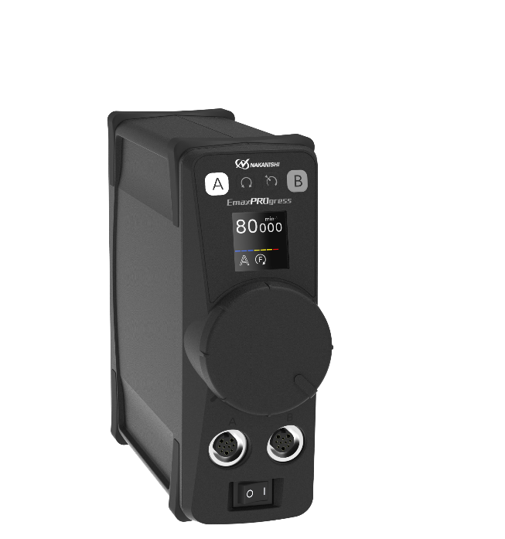
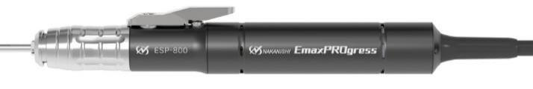
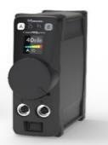

The Evolution of Micro Grinders
In 2026, the EmaxPROgress is finally making its debut.
The control system has been newly updated to 180-degree vector control.
Inheriting the legacy of Emax EVOlution and Espert 500,
it features a new motor capable of 80,000 min⁻¹.
The newly developed motor uses an amorphous core for low heat generation.
 | Brushed | Brushless
1984
1990
1992
2000
2001
2008
2026
Electer
Electer
GX
Espert
Brushless motor
1,000–80,000 min⁻¹
200 W
Espert
500
Electer
E-Max
Emax
EVO
Emax
PROgress

Slide 11
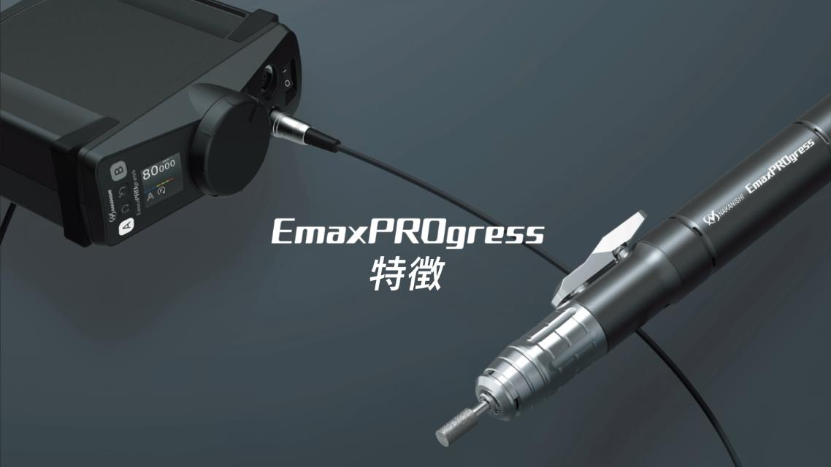
Features

Slide 12
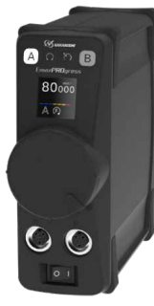
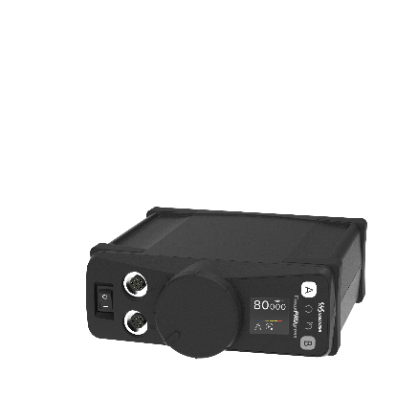
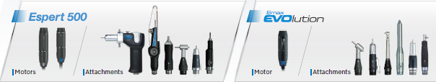
Features: Controller
• Can be placed vertically or horizontally
  The controller can be set up vertically or in either of two horizontal orientations to suit the installation space and layout. The display orientation can also be adjusted.
• Lightweight body
  The controller weighs just 1.25 kg, a reduction of more than 50% from the previous model. The packaging box's volume and weight have likewise been cut by more than 50%.
• Can connect two handpieces
  Two handpiece sets can be connected at once (simultaneous use of both is not supported). Switching channels according to the task makes work more efficient.
• Compatible with Espert 500 and Emax EVOlution motors
  All Espert 500 and Emax EVOlution motors can be used.

Slide 13
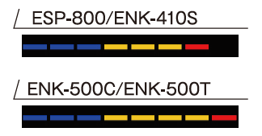
Features: Controller
• Load visualization via the load meter
  A built-in LOAD meter displays the current load condition.
  Making the load ratio visible helps standardize work procedures.
  *The meter's display changes depending on the motor connected, allowing for more reliable visualization.
• Rotation speed display and control increments
A 5-digit rotation speed display. Motors rated at 50,000 min⁻¹ or below are controlled in increments of 200 min⁻¹; the 80,000 min⁻¹ motor is controlled in increments of 500 min⁻¹.
• Various convenience features
  Features such as auto-cruise and rotation speed memory are retained from previous models.
• Enhancement of various safety features
  Equipped with safety features such as overheating protection, a load warning sound, and acceleration selection. Extensive safeguards prevent accidental high-speed rotation when the power is turned on or when a motor is connected.
  For example:
  • If the foot pedal is pressed when the power is turned on, a warning sounds and 'FOOT CTRL PROHIBIT' appears on the screen.
  • For motors with a maximum speed above 40,000 min⁻¹, the speed is limited to 40,000 min⁻¹ if the speed control knob is not at the minimum position. This applies when the power is turned on or a motor is connected. Turning the speed control knob to the minimum position will remove this limit.

Slide 14
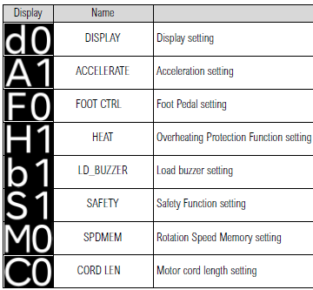
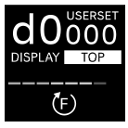
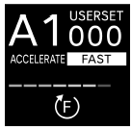
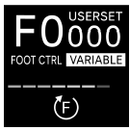
Features: Controller
• Newly added user-setting mode
  Settings can now be customized to suit each user’s preferences.
→ Select the display orientation: vertical or either of two horizontal orientations
→ Select high acceleration (FAST) or low acceleration (SLOW)
→ Select variable-speed control (VARIABLE) or ON/OFF control
→
→
→ Turn overheating protection ON or OFF
→ Turn the load warning sound ON or OFF
→ Select a 40,000 min⁻¹ speed limit, motor operation disabled, or safety function OFF
→ Select the FIXPEED function or a speed limit
→ Select a motor cord length of 1.5 m or 3.0/4.0 m
Text information is now shown on the display, making it easier to understand.

Slide 15
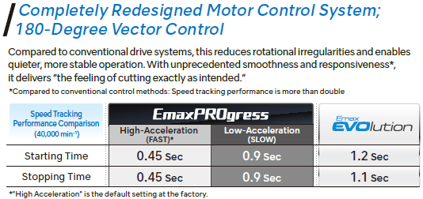
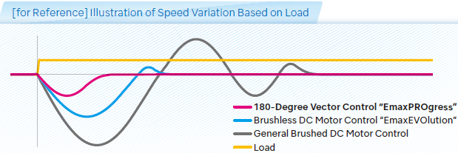
Features: Controller
• Smooth rotation through vector control
  The motor control system has been redesigned to adopt 180-degree vector control. Compared with the previous system, it suppresses uneven rotation, enabling quieter, more stable operation. With unprecedented smoothness and speed responsiveness that has more than doubled compared with the previous model, it enables material removal exactly as intended.
*ENK-410S
Vector control also shortens motor start/stop times while reducing the reaction felt in the hand.

Slide 16


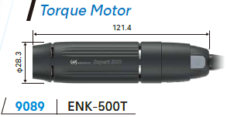



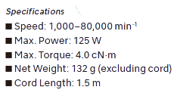

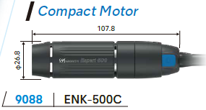
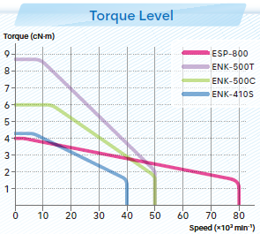


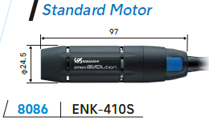

Features: Motors – Four Types of Motors

Slide 17
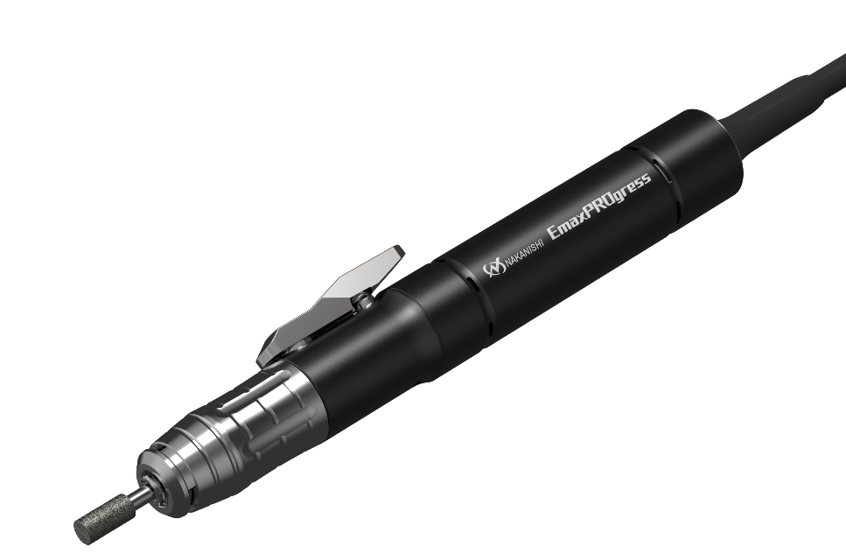
Features: Motors – 80,000 min⁻¹
• Newly developed 80,000 min⁻¹ high-speed motor
  A top speed of 80,000 min⁻¹ enables even more precise, fine grinding than before. Stable rotation contributes to a precise finish.
• Reduced heat generation
  Adopting an amorphous core keeps heat generation low even at high speed, allowing for smooth grinding. We achieved an approximately 39% reduction in temperature rise ΔT.
• Compact and lightweight: 132 g
  A compact design that fits comfortably in the hand.
  Weight is reduced by up to 48% compared with previous
  motor-and-handpiece combinations.
  Comparable in weight to the UHT MSG-3BSPlus.
• Uses a high-efficiency brushless DC motor

Slide 18
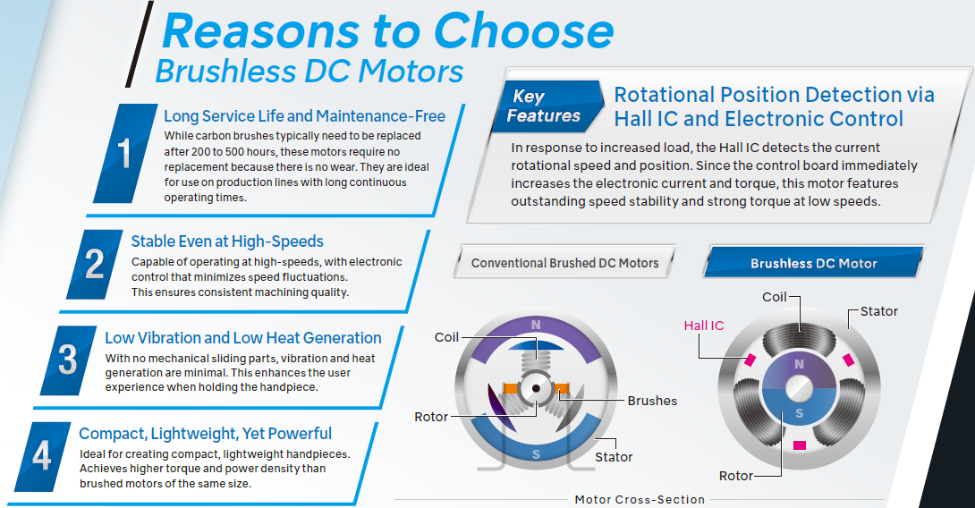

Features: Motors – Brushless DC Motor

Slide 19
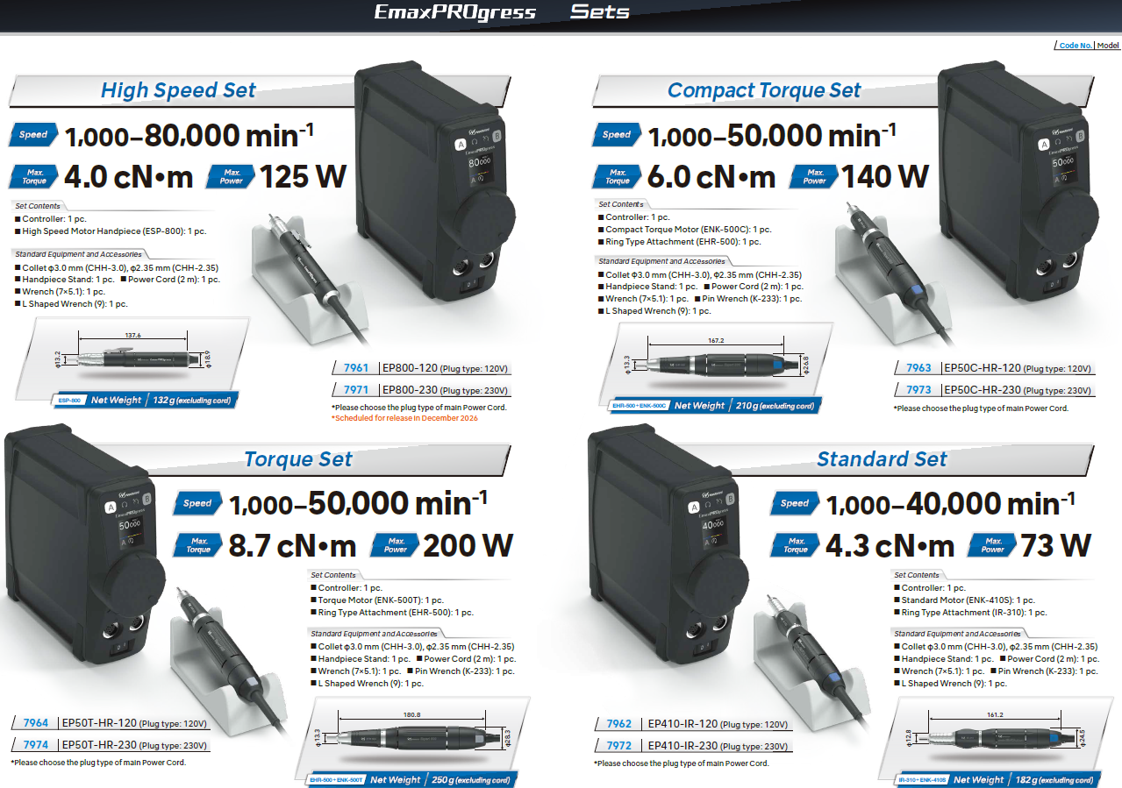
EmaxPROgress Sets

Slide 20
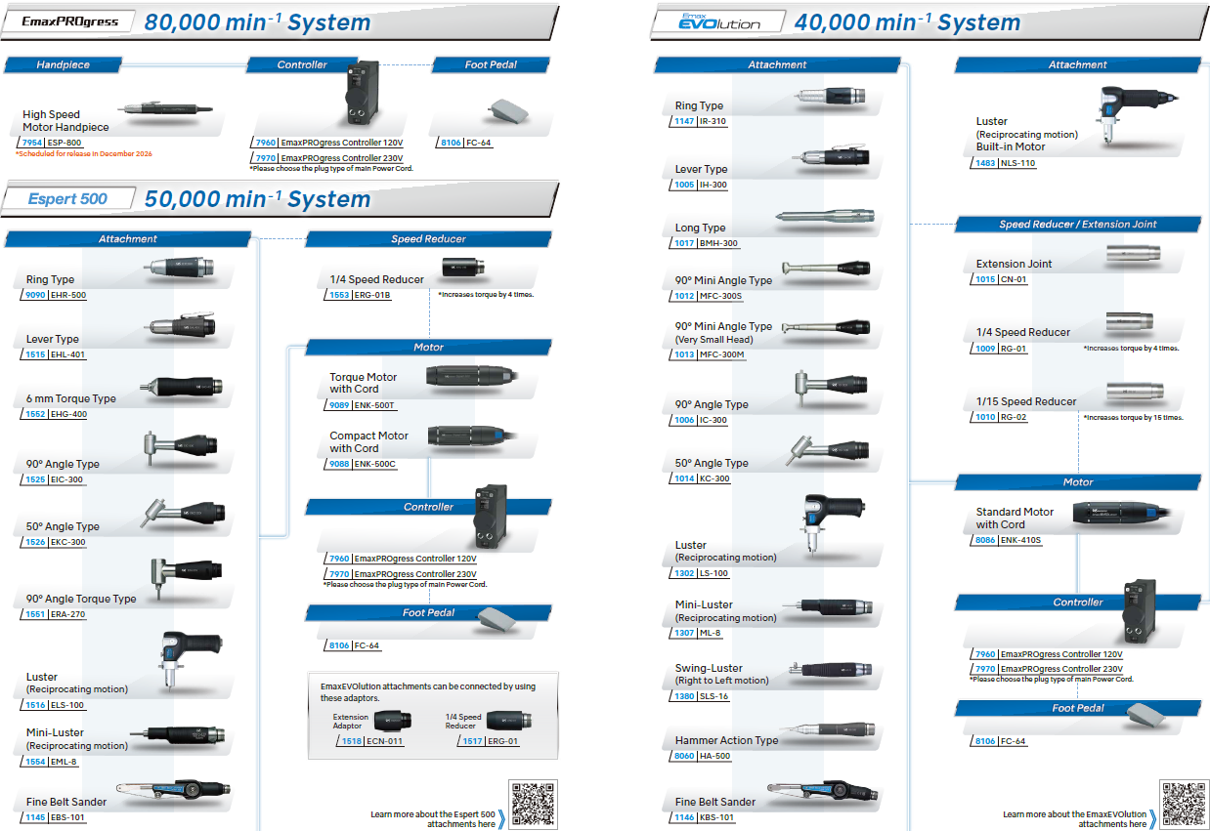
System Diagram

Slide 21



